Slide 1
Welcome to MA Academic Practice in Art, Design and Communication
Catherine Smith, Frederico Matos, John O’Reilly
09.01.24
Notes:
Intro to tutors. Each say a few words about background.

Slide 2
What is your academic practice world?
‘Practices of Enquiry’ (7–18 November 2016)
Curated by Elliott Burns and Catherine Smith
Cookhouse Gallery, Chelsea College of Arts. Image © Catherine Smith
Notes:
Tutors to introduce themselves + research interests.
Participants then take 5 minutes to introduce themselves to rest of their table. Name, job role, reason for doing the MA, proposed area to research.

Slide 3
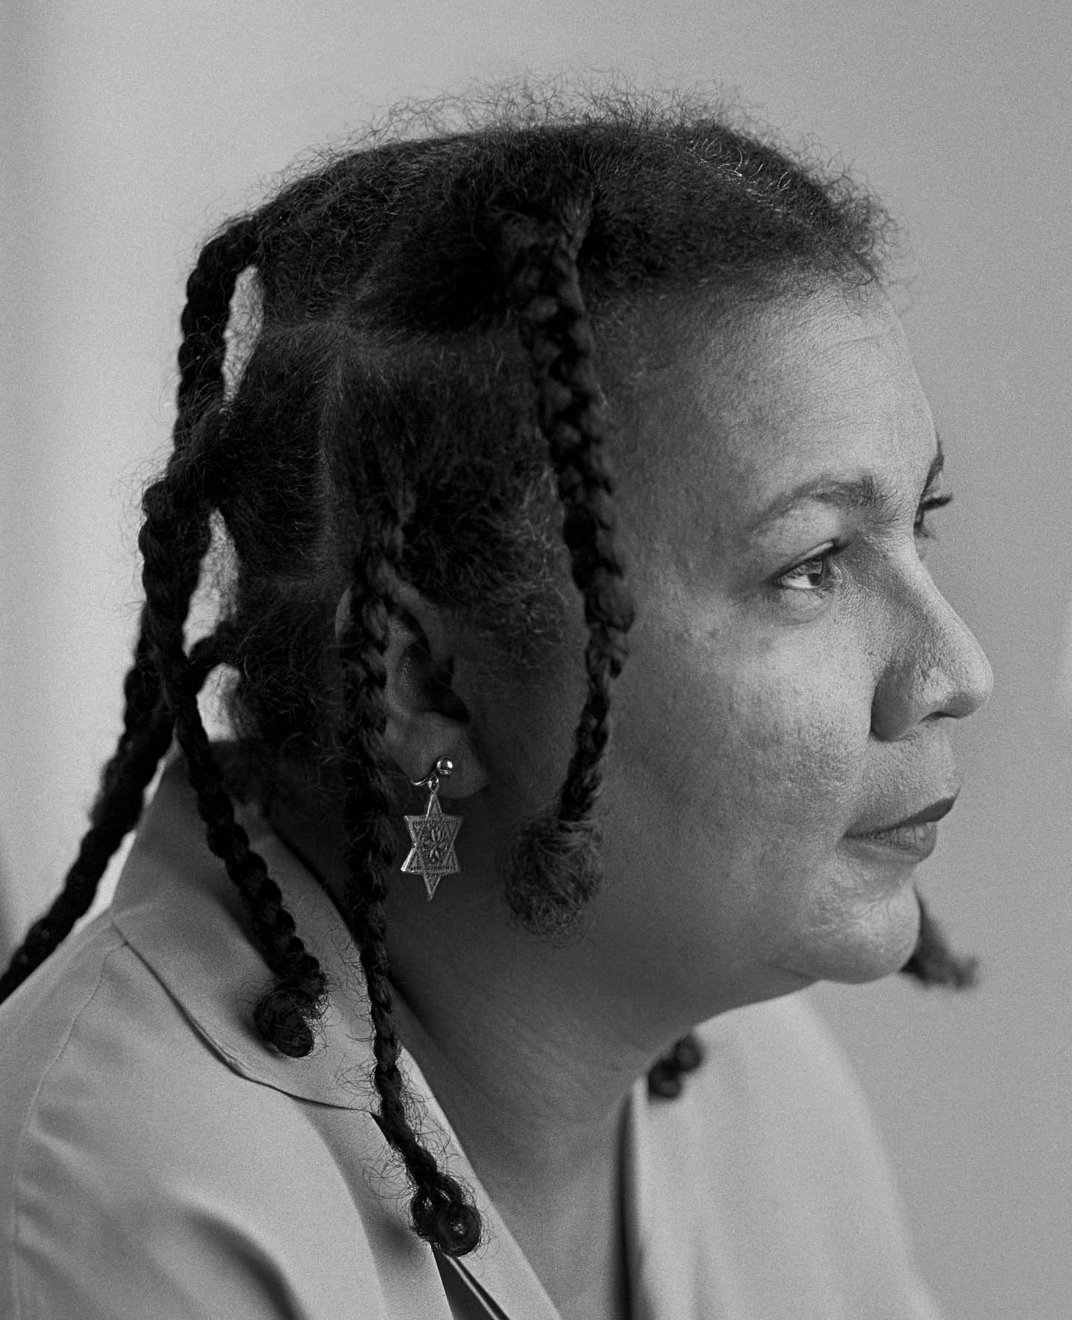
On community… “…it is crucial that that critical thinkers who want to change our teaching practices talk to one another, collaborate in a discussion that crosses boundaries and creates space for intervention.” (hooks, 1994, p.129)
Notes:
Programme = a community of academic practice & scholarship

Slide 4
On ethical spaces… Ethics is creative and relational. It is in every action and interaction we make. Everyone is an expert. Everyone brings knowledges and practices that we can learn from. Everyone is an educator. We facilitate each other’s learning. Critical friendship. Ask respectful questions, sensitively. Be kind. Active listening, supportive responses. Be kind to yourself. Pace yourself, take breaks, little by little. Etiquette. Use hands up (or chat online) for questions.

Slide 5
On noticing… “To develop your professional practice means to increase the range and to decrease the grain size of relevant things you notice, all in order to make informed choices as to how to act in the moment, how to respond to situations as they emerge.” (Mason, 2002, p.xi)
Notes:
John Mason on noticing / Susan Orr on itches to scratch.

Slide 6
On research… “…research is not an innocent or distant academic exercise but an activity that has something at stake and that occurs in a set of political and social conditions.” (Tuhiwai Smith, 1999/2021, p.5)
Notes:
We are not expecting you to all to be the same or have the same professional experiences or areas interest. Everyone does utterly different things.
Things that matter to them. That is what matters to us – to provide the space to do the work that matters to you.

Slide 7
No one reads the handbook - To transform arts higher education by cultivating inclusive, ethical academic practices. - To provide you with opportunities to develop your own academic practice through reviewing and evaluating the scholarship and practices of others. - To enable you to continually enhance your teaching in a way that responds to the complex and evolving contexts of institution, policy and society. - To support you to critically relate educational theory to your disciplinary knowledge, and apply it to practice. - To value the interests, experience and expertise you bring to course activities and assessment. - To ignite your curiosity via engagement with a dynamic programme community.
Notes:
Course Learning Outcomes.

Slide 8
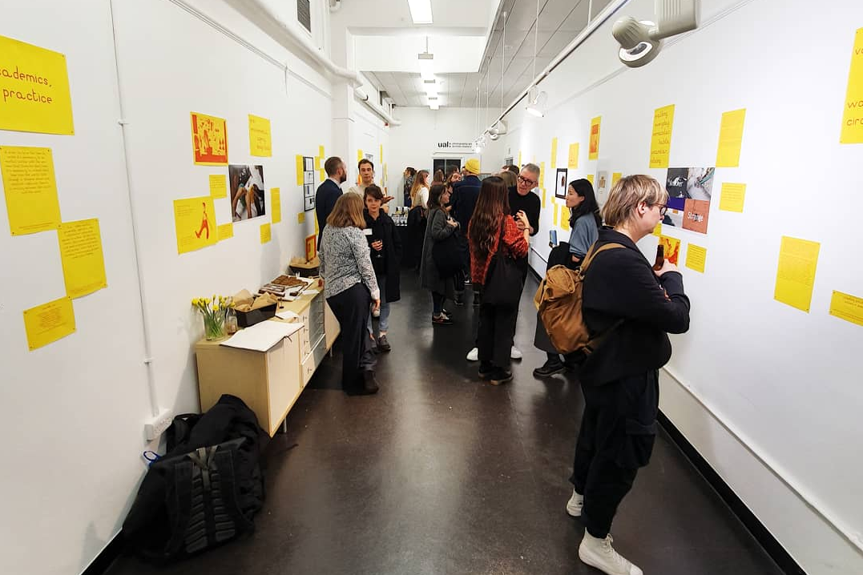
‘Academics in Practice’ (18 February – 5 March 2020)
Curated by Catherine Smith for Research Season 2020
PARC Gallery, London College of Communication. Image © Rachel Marsden
Notes:
We have a practice of sharing and exhibiting our research. This was pre-pandemic. We have the Spark Journal also. D&I unit presentations.

Slide 9
Recent Major Project topics - ‘Sonic Symbiography’ by Miriam Elgon - ‘Liquid Blackness’ by Rayvenn Shaleigha D’Clark - ‘Cripping the Crit’ by Carys Kennedy - ‘Thinking Through Making’ by Verity Cleary - ‘Drawing, Pedagogy, Ethnography’ by Trudi Esberger - ‘The Film Editor as Rhythmanalyst’ by Michael Ho
Notes:
Questions

Slide 10
Questions so far? …coffee break!

Slide 11
MA course structure 60 credits from PgCert (or AAC/APEL) ✔ +
Research Methods & Practices
(40 credits)
spring & summer terms
Unit leads: John & Frederico
Major Project
(60 credits)
autumn, spring, summer terms
Unit lead: Catherine
Dissemination & Impact
(20 credits)
autumn term
Unit leads: Catherine & John
Cross-programme monthly events:
guest lectures, practice workshops, research seminars

Slide 12
MA course unit schedule Over 2 years: Research Methods & Practices: Jan > July 2024 Major Project: Sept 2024 > Sept 2025 Dissemination & Impact: Oct > Dec 2025 The MA must be completed within 3 years (so by Jan 2027 latest). Always contact the Course Leader if you are considering taking time out from study.

Slide 13
Academic Practice event series (online) Wednesday afternoons from 24 January 2024 from 2-4pm. 3 per term. Spring events: Wed 24 Jan: Judy Willcocks & Georgina Orgill on ‘Object-Based Learning’ Wed 14 Feb: Dr Annamarie McKie on ‘Reflection in the Creative Arts’ Wed 13 March: tbc Schedule & Collaborate link is on Moodle MA homepage. Will be recorded but please try and attend.

Slide 14
Tutorials Each unit has a specific allocation of tutorials. Additional termly tutorials can be organised with the Course Leader on a request basis (these are optional and can be pastoral and/or academic in focus). See Tutorial Policy under ‘Essential Info’ on Moodle.

Slide 15
Course communication Forward your student email address to your UAL email address. Check you can access all the units you are enrolled onto, on Moodle. If you cannot, please email Mark Armstrong: m.m.armstrong@arts.ac.uk Email your unit tutor for unit related questions, email academicpractice@arts.ac.uk re. admin concerns, email the Course Leader re. anything else!
Notes:
Moodle is our Virtual Learning Environment (VLE). Show the course page.

Slide 16
Student support UAL Disability Services: https://www.arts.ac.uk/students/student-services/disability-and-dyslexia To arrange a meeting with Disability Services: disability@arts.ac.uk Becky Keen: b.keen@arts.ac.uk To access individual academic support: https://academicsupportonline.arts.ac.uk/

Slide 17
Student representative nominations Any volunteers? Seek feedback from the cohort beyond unit evaluation. Represent interests of the MA participant body. Attend termly Programme Committees (2 per year); Academic/Quality Committees (2 per year). Full description of role here: https://www.arts-su.com/yourvoice/coursereps/
Notes:
We need 2 for MA so you won’t have to attend it all.
Committee attendance as prof dev for leadership.

Slide 18
Mapping our knowledges - What do you know? - What skills and knowledges are you bringing to the course? (It can be anything: artistic, scholarly, hobbies, obscure…) - Free writing exercise. - For 5 minutes write everything you know down. Don’t stop, just write continuously. - Share in your table group.
Notes:
Move tables, talk to new people. 15 mins.

Slide 19
Any questions? Contact details: c.h.smith@arts.ac.uk f.matos@arts.ac.uk john.oreilly@arts.ac.uk academicpractice@arts.ac.uk

Slide 20
References hooks, b. (1994) Teaching to Transgress: Education as the Practice of Freedom. Abingdon: Routledge. Mason, J. (2002) Researching Your Own Practice: The Discipline of Noticing. Abingdon: Routledge. Tuhiwai Smith, L. (1999/2021) Decolonizing Methodologies: Research and Indigenous Peoples. 3rd edn. London: Zed Books.

